Slide 1
CSS Fundamentals
Cascade Styling Sheet
& Responsive Web Design

Slide 2
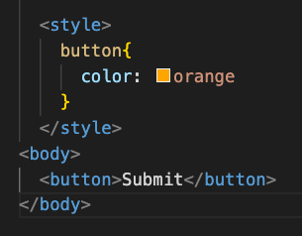
How to add CSS into HTML?
Inline : <button style="color:orange">Submit</button>
Internal :
External : <link rel="stylesheet" href="index.css" />

Slide 3
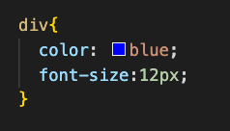
CSS Syntax
CSS Selectors
CSS Property
Value
Block

Slide 4
CSS Selectors
Basic Selectors : id, class, tag
#Mean
.Mean
Mean
CSS Class Combinators : https://frontend30.com/css-selectors-cheatsheet/

Slide 5
CSS Inheritance
Inherited Properties : font-size, color, text-align
Non-inherited properties: border, margin
https://dev.to/muyunyun/inherited-and-non-inherited-in-css-mi4

Slide 6
What is the priority of the CSS
Inline > Internal = External(decided by the order)
Id > Class > TagName
Value defined as :
Important > Inline >id nesting > id > class nesting > class > tag nesting > tag

Slide 7

CSS Box Model
Margin : Clears an area outside the border. The margin is transparent
Border : A border that goes around the padding and content
Padding : Clears an area around the content. The padding is transparent
Box-sizing: border-box content-box

Slide 8
Position
https://www.w3schools.com/css/css_positioning.asp

Slide 9
Display
Inline vs. Block
Inline-Block
Dislay: none VS. Visibility: hidden
https://www.w3schools.com/css/css_display_visibility.asp

Slide 10
Flexbox VS. Grid
Flexbox : https://yoksel.github.io/flex-cheatsheet/
1 Dimensional
Grid Layout : https://yoksel.github.io/grid-cheatsheet/
2 Dimensionals
Notes:
https://css-tricks.com/snippets/css/a-guide-to-flexbox/
https://css-tricks.com/snippets/css/complete-guide-grid/

Slide 11
Z - index
https://www.w3schools.com/css/css_z-index.asp

Slide 12
*SASS
Declare Variables
Nesting Format
@mixin @include ===> Create Functions
https://sass-lang.com/

Slide 13
Responsive Web Design
Flexbox / Grid
Relative units : https://www.w3schools.com/cssref/css_units.asp
*Media Query :
https://www.w3schools.com/css/css_rwd_mediaqueries.asp

Slide 14
*What is Cross Browser Issue?
CSS Reset / CSS Normalization
Vendor Prefix
How to test:
www.caniuse.com
https://www.browserstack.com/
Notes:
https://developer.mozilla.org/en-US/docs/Glossary/Vendor_Prefix

Slide 15
BEM- Block Element Modifier
— A standard and telling how to give names to css class/id
http://getbem.com/naming/

